Slide 1



Department of Management Studies Estd. 2004
www.newhorizonindia.edu
1

Slide 2

Expert Corporate Trainer – 24+ years of experience in leadership development, team building, performance management, cross-cultural training and in enhancing organizational excellence.
Certified Industry Specialist – Holds certifications in TTT (Infosys), NLP, Appreciative Inquiry, and Situational Leadership (Ken Blanchard) and utilizes psychometric analysis, case studies, and management games.
Prestigious Industry Collaborations – Delivered training for leading organizations such as IpInfusion, Airtel, CGI-Logica, Marico India Ltd, HAL, Novotel, and NOVONORDISK, along with 15+ years as a corporate trainer for CII.
Prolific Researcher & Author – Published 68+ research papers in UGC and Scopus-indexed journals, specializing in HR, OB and Digital business-authored seven management books.
Tailored, High-Impact Training – Designs and delivers customized, interactive, results-driven programs to meet specific corporate needs & drives organizational growth.
Dr Rose Kavitha

Slide 3

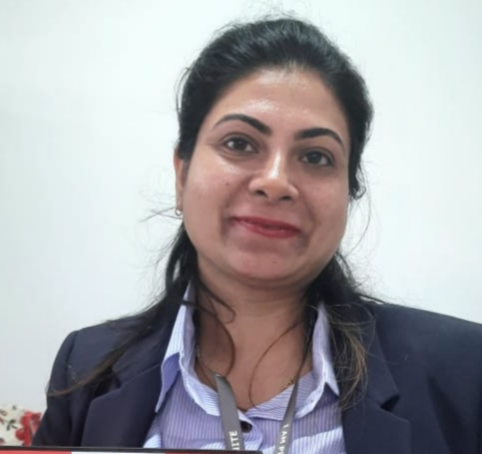
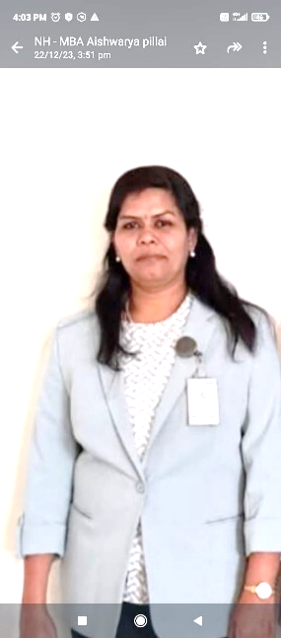
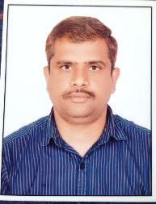
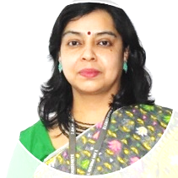
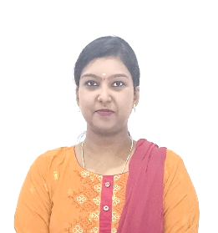

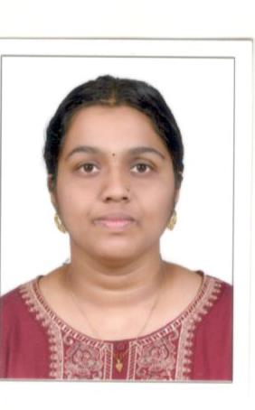
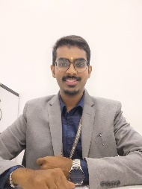
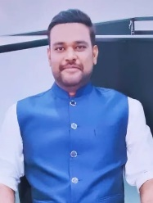
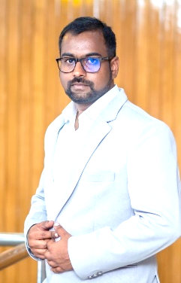
Faculty-MBA
Dr. Rose Kavitha Professor
Dr. Priyameet Kaur Keer
Professor
Dr. Dhanalakshmi RV
Associate Professor
Mr. Sheshu A N
Sr. Assistant Professor
Ms Saumi Roy
Sr. Assistant Professor
Ms. Shalini SN
Assistant Professor
Ms. Ankita Jeewankar
Assistant Professor
Mr. Rajat Hubballi
Assistant Professor
Mr. Madhuraj CA
Assistant Professor
Mr. Naresh KV
Assistant Professor
Dr. Neelima Ravindran
Assistant Professor

Slide 4


PROGRAMS OFFERED
2 years full time MBA (Four Semesters),
autonomous program.
MBA (Dual Specialization) in the areas of:
Marketing
Finance
Human Resource
Logistics and Supply chain management
Artificial Intelligence and Data Science
Ph.D in all the related areas of Management

Slide 5

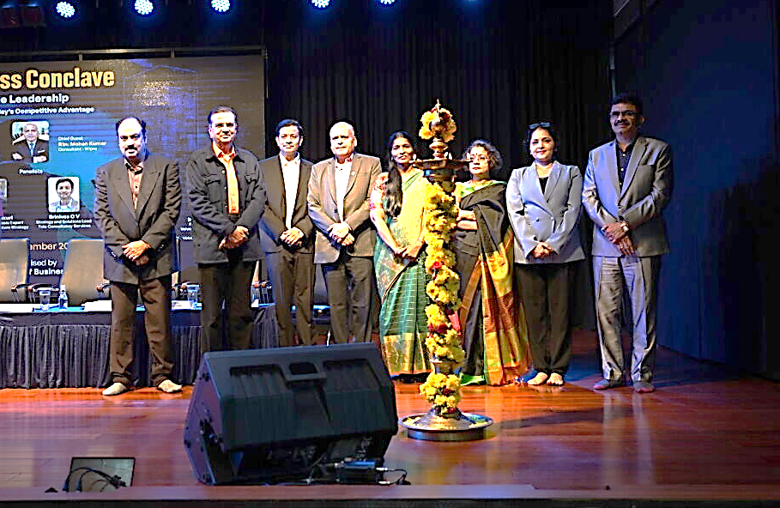
Events @ MBA Department
BUSINESS CONCLAVE 2026
ALUMNI TALK 2026

Slide 6
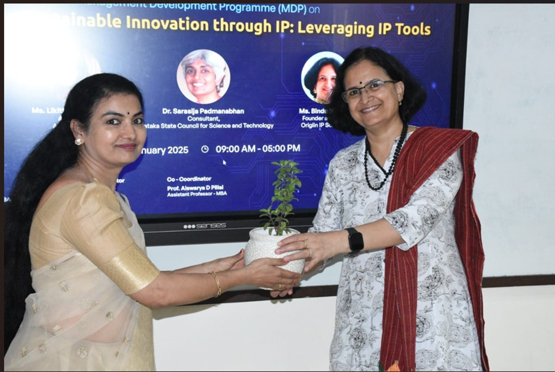
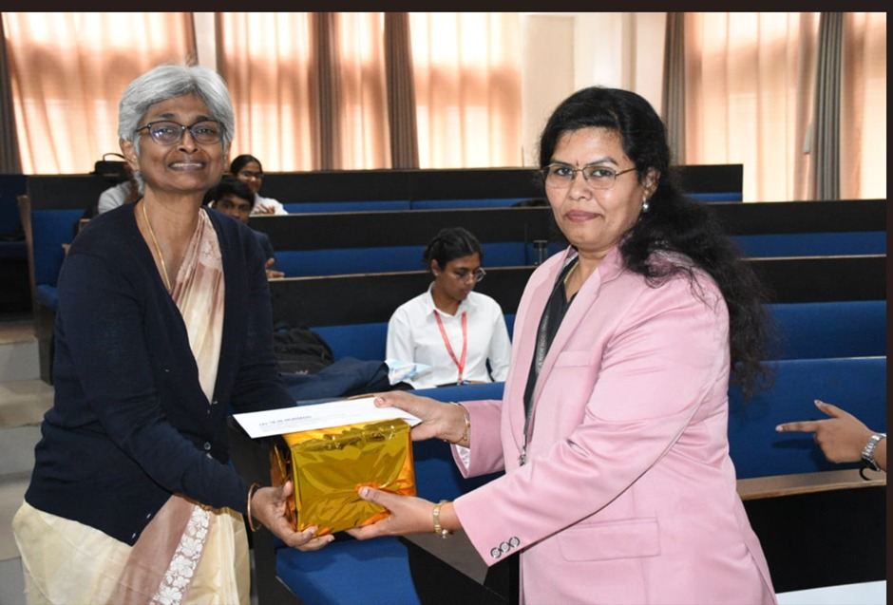
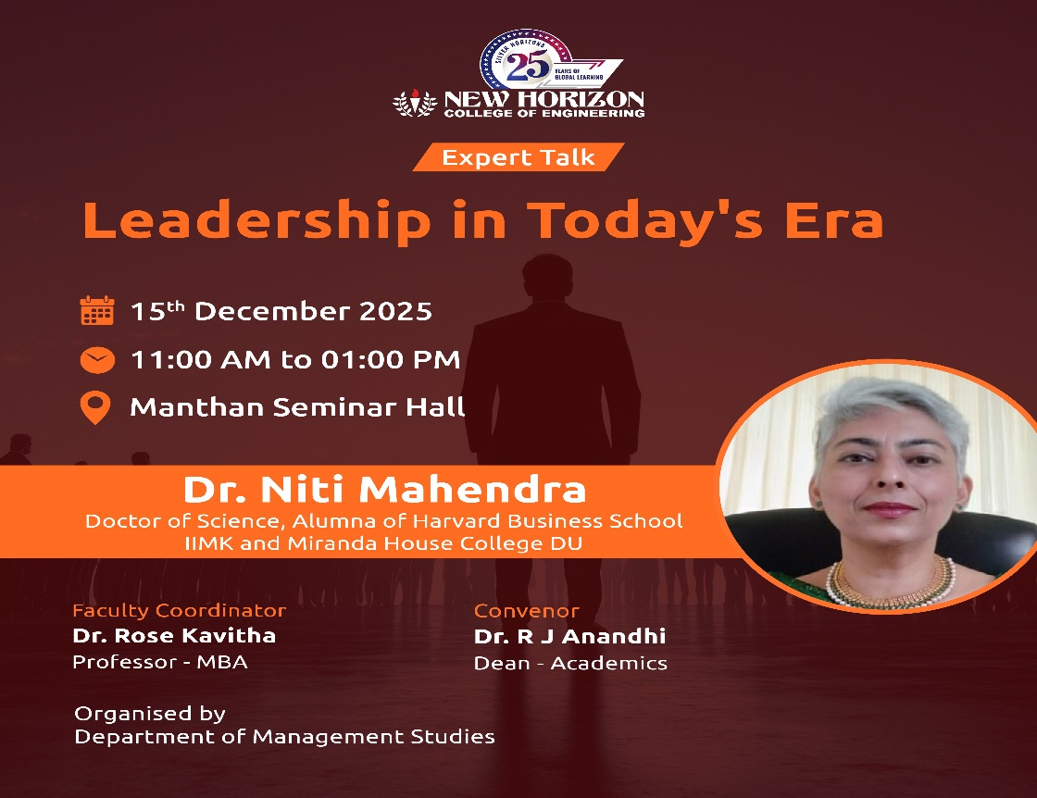
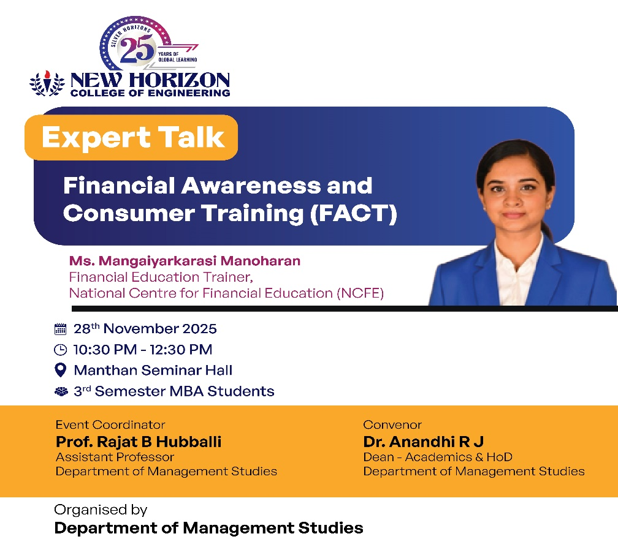

Slide 7
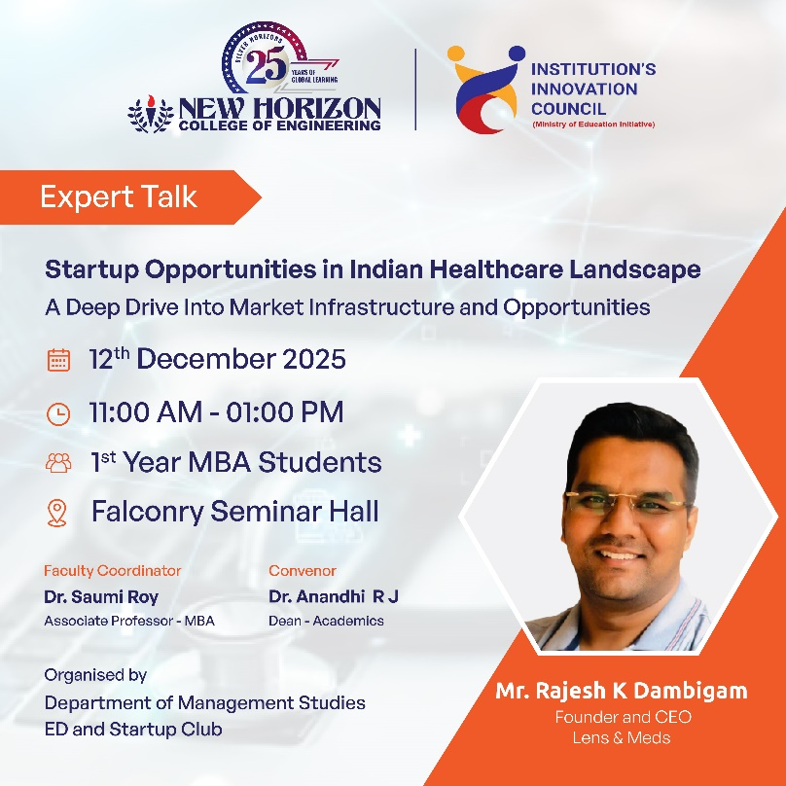
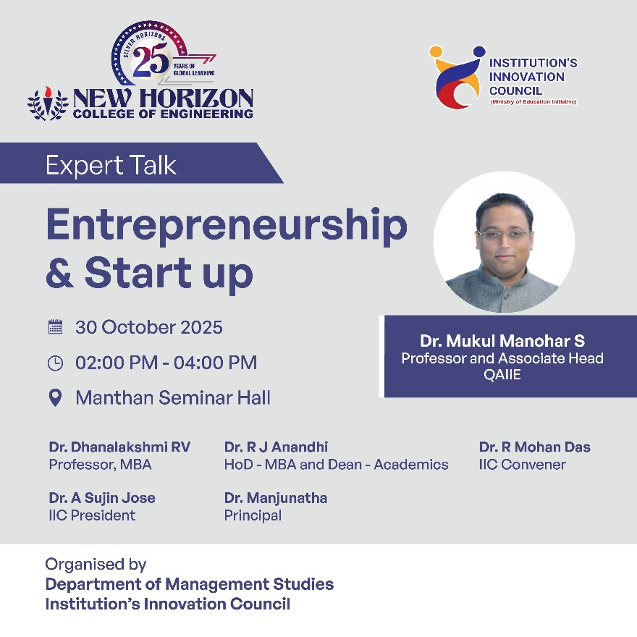
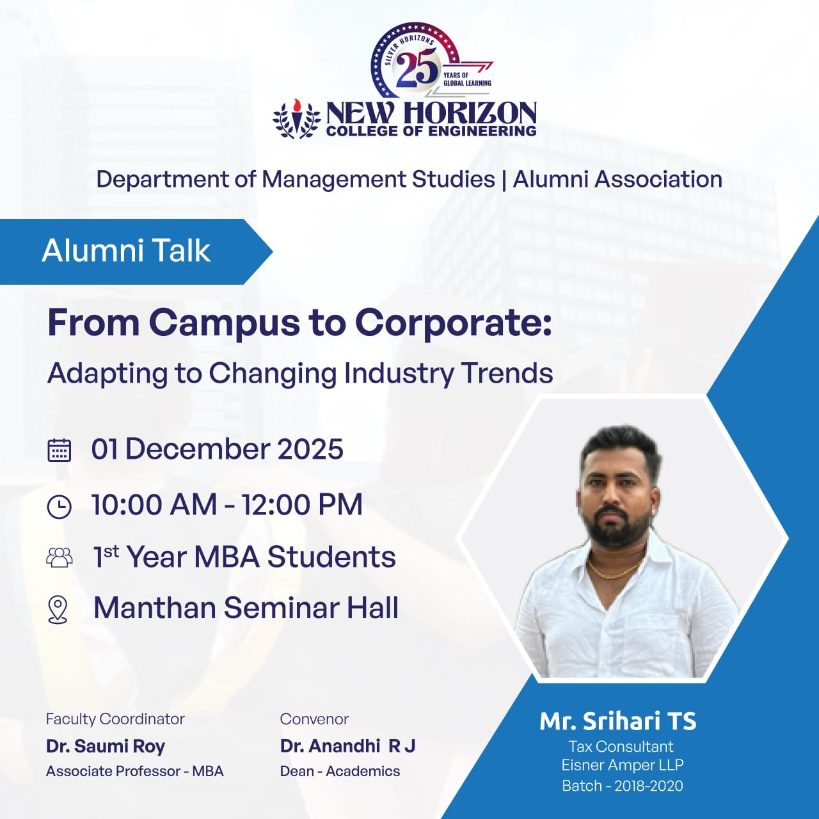
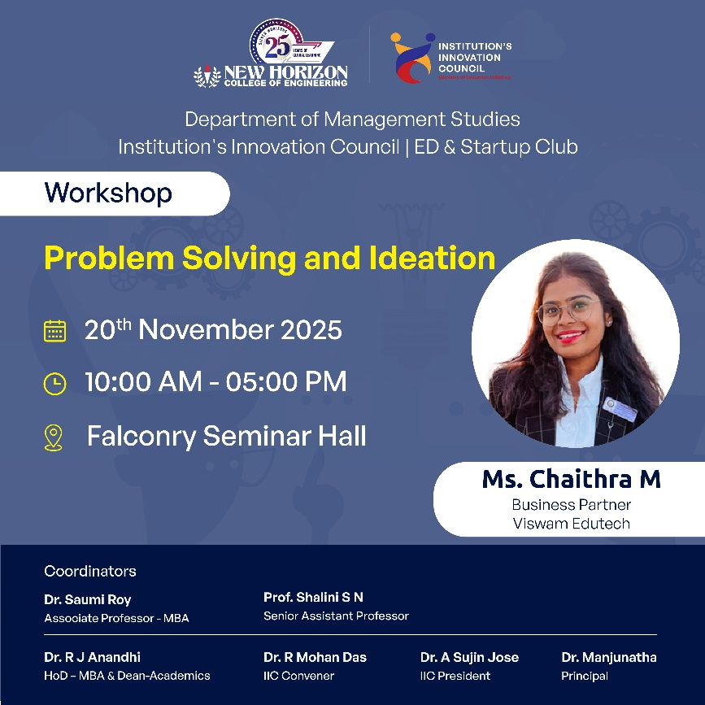

Slide 8



Pre-Placement Training
Training in Business English, Soft Skills Training, Quantitative Aptitude Training , Interview Skills Prep workshop
CV writing workshop will be provided to the students at an extra cost.
VTU Consortium e-resources packages will be provided to the students.

Slide 9
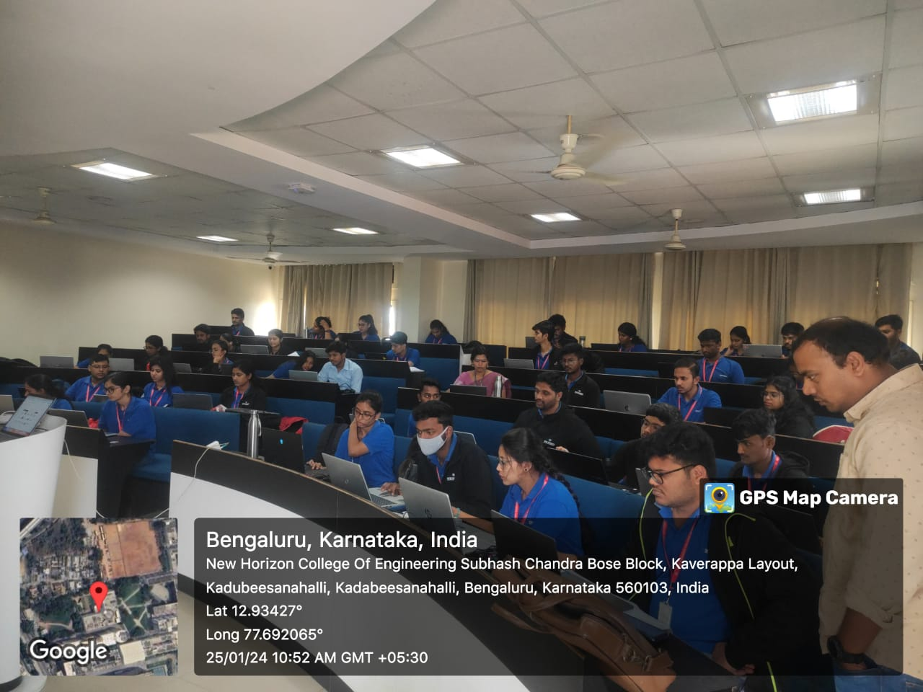
Value Added Programs
Sl.No | Details
1 | Domain certification on visual Analytics Using Power BI
2 | IIMBx Online Certification Course on Managing Innovation
3 | Domain certification on visual Analytics Using Power BI
4 | HBx Online Courses Business Analytics
5 | Domain Certificate Fintech
6 | Capstone Business Stimulation
7 | HBx Online Courses Business Analytics
8 | IIMBx Online Courses on Strategy and Sustainable Enterprise

Slide 10
CO-CURRICULAR
EXTRA-CURRICULAR
5 Workshops per semester
Guest lectures/Industry Expert Lectures from the industry
Industrial visits
Best Patent/Project Contest
International / National Conferences/ Entrepreneurship
Summits
National level Symposium & paper presentation competition
Business Conclave
Research paper presentations
DATA ANALYTICS CLUB
Provides Technical and Theoretical know how about Analytical tools in demand
Equips students with Analytical
Tools required for Business
Run by Analytics enthusiastic students
Inter collegiate fest- SARGAM
Entrepreneurship Development &
Startup Club
Entrepreneurship awareness - programmes
Business plan workshops
Ideas pitch
Supporting with Incubation

Slide 11
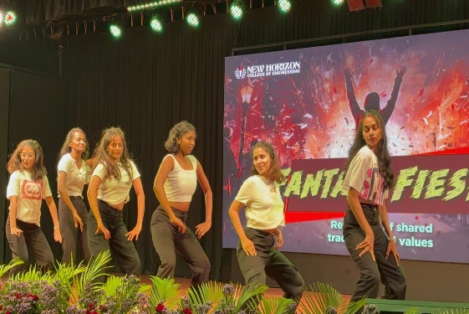
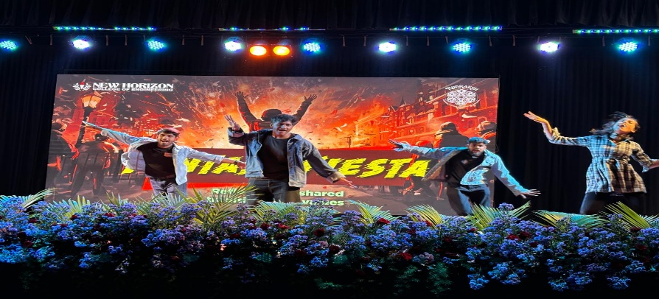

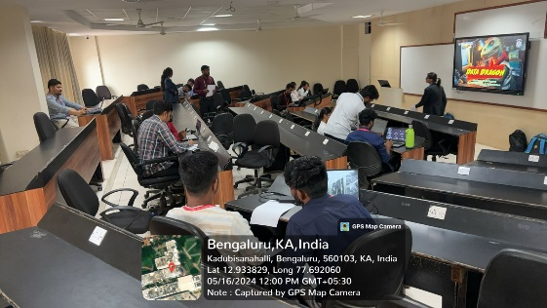


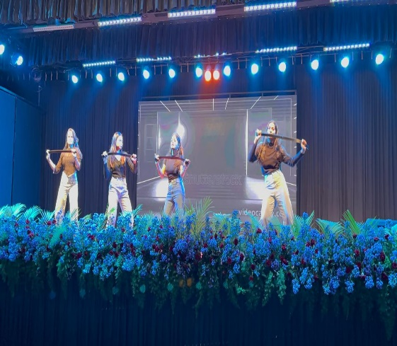
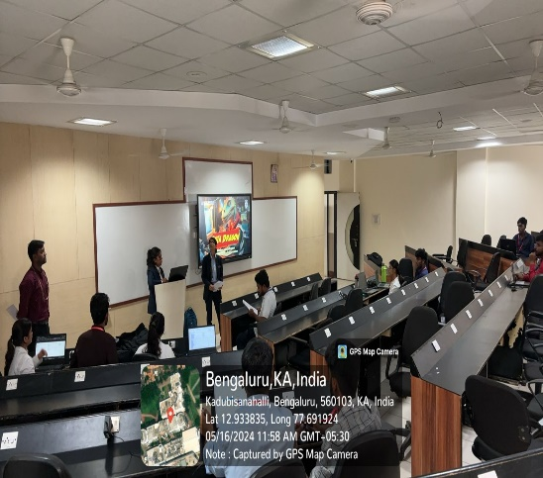
Management Fest: RUDRAKSH
8
Events
10
Events

Slide 12

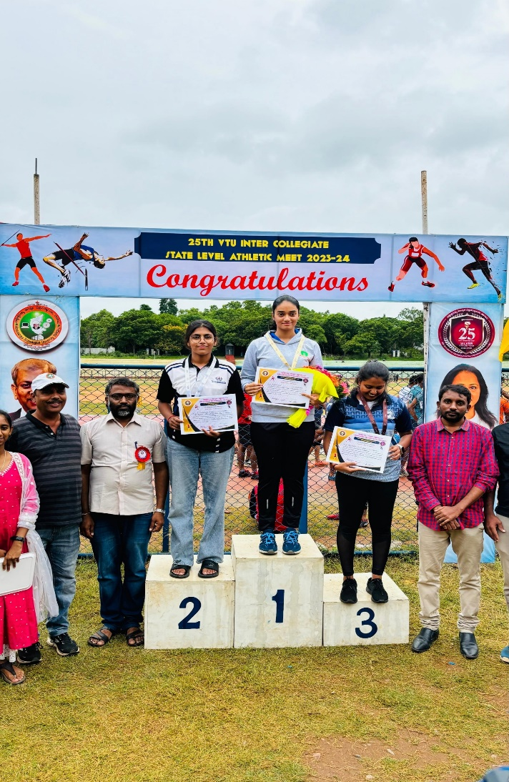
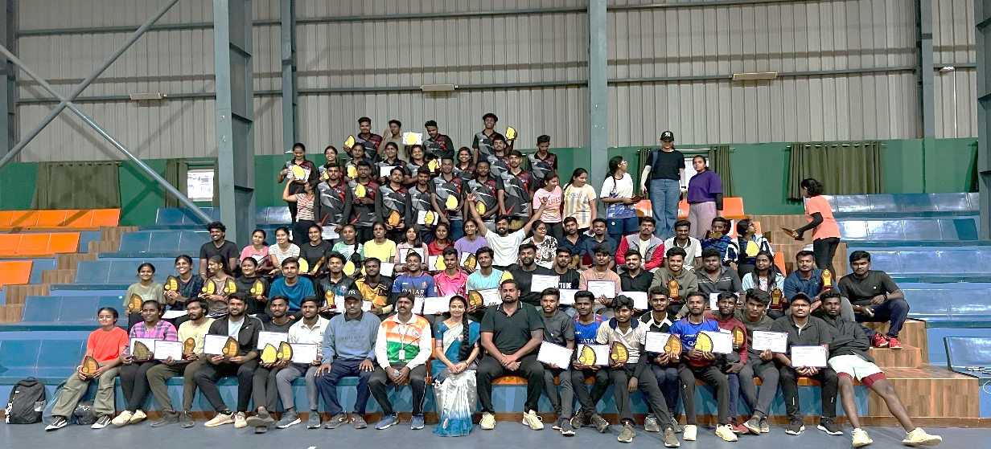
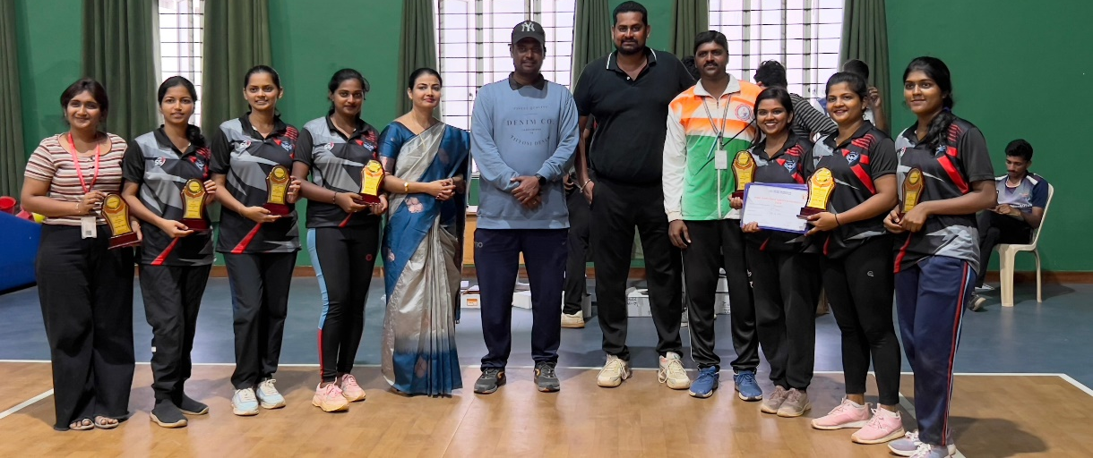
Students Achievements in Sports

Slide 13

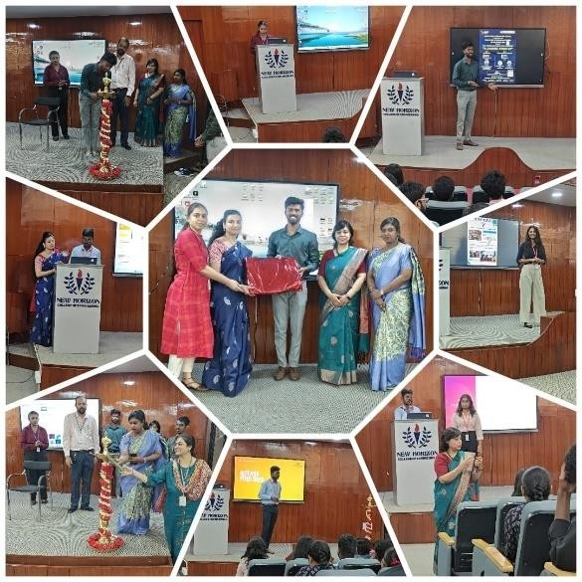


SOCIAL OUTREACH AND EXTENSION ACTIVITIES
Rural development programmes
Unnat Bharat Yojna (UBA) – Ministry of HRD
Five villages are adopted
Social awareness drives in these villages every semester
Plastic free campaign in the villages

Slide 14
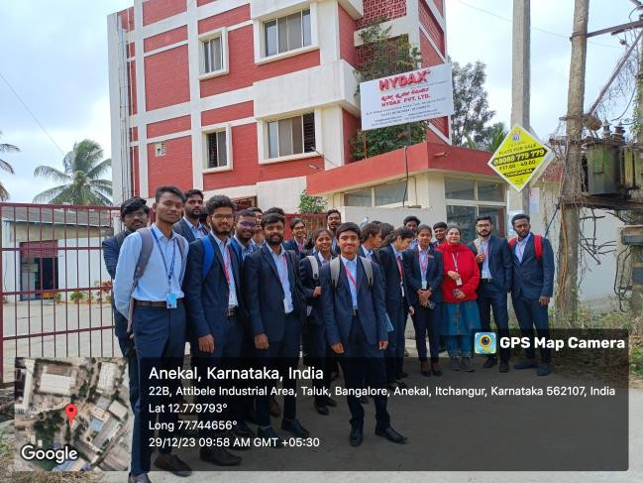
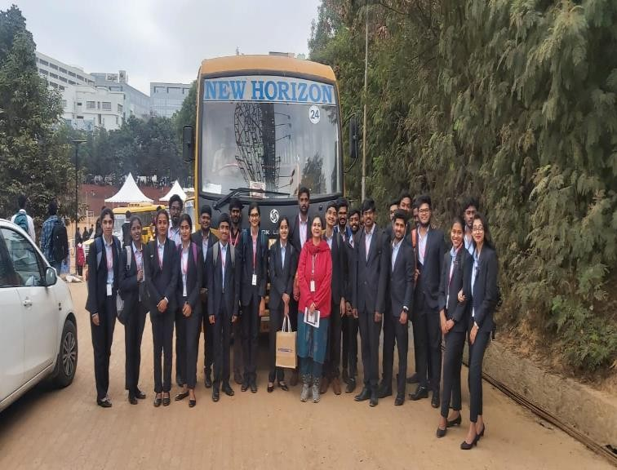
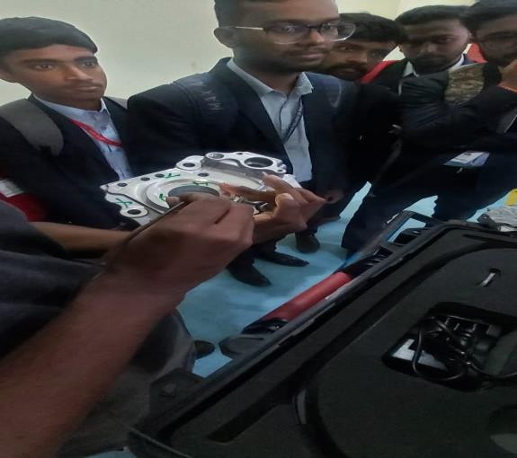
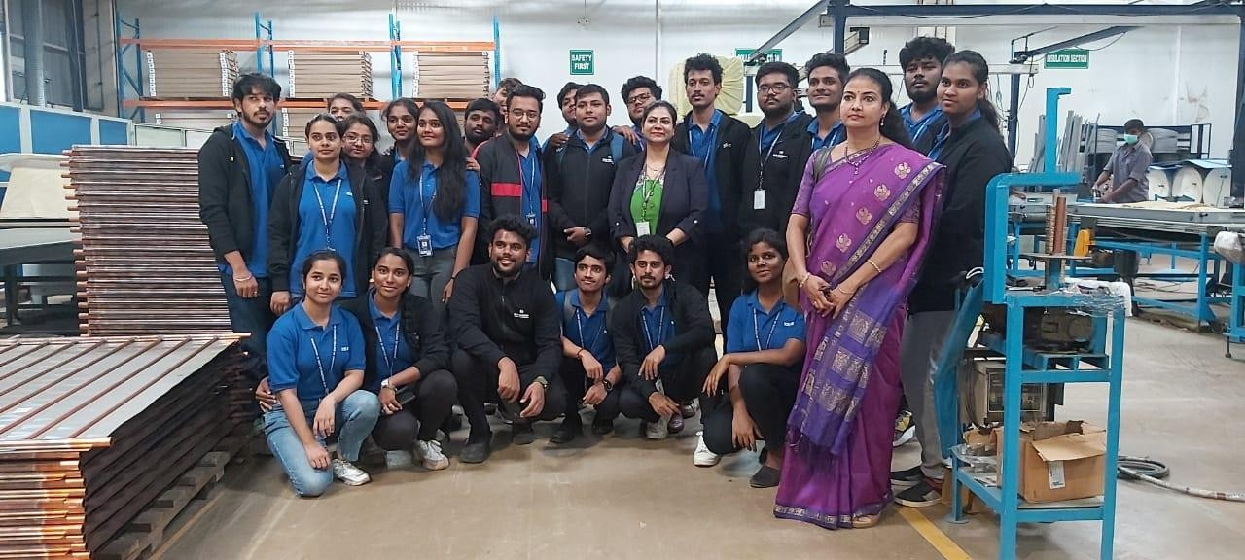
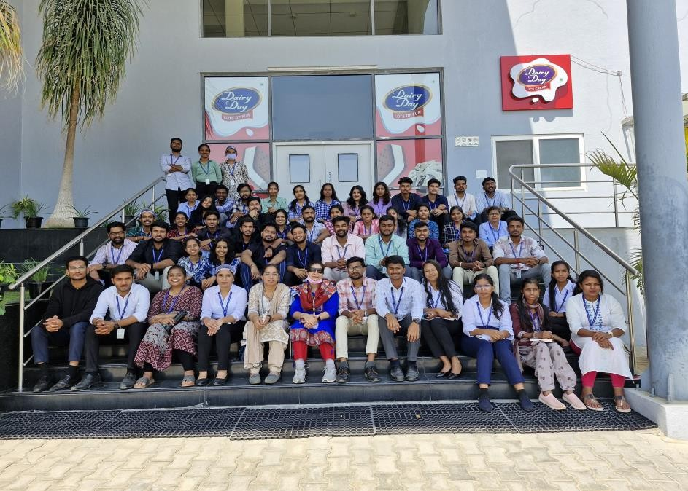
Glimpse of Industrial Visits

Slide 15
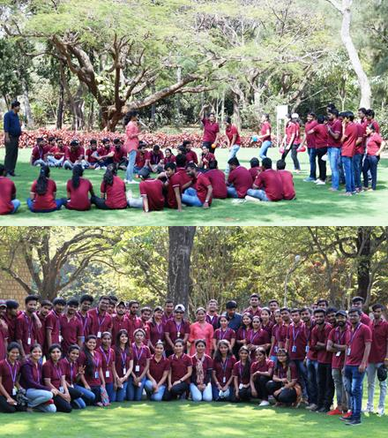
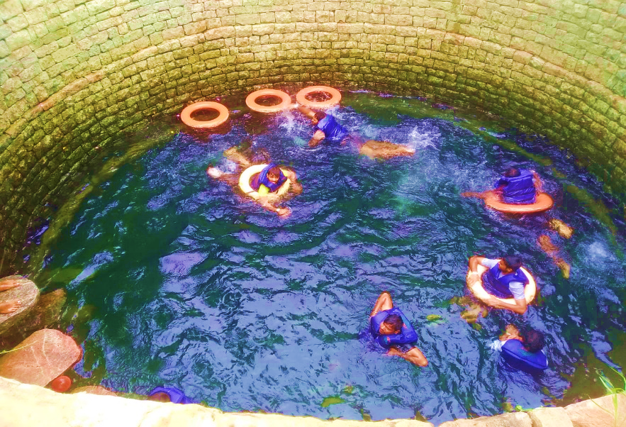
OUTBOUND EXPERIENTIAL TRAINING PROGRAMME
Two days residential programme
Team building
Creative thinking
Public speaking
Confidence building

Slide 16
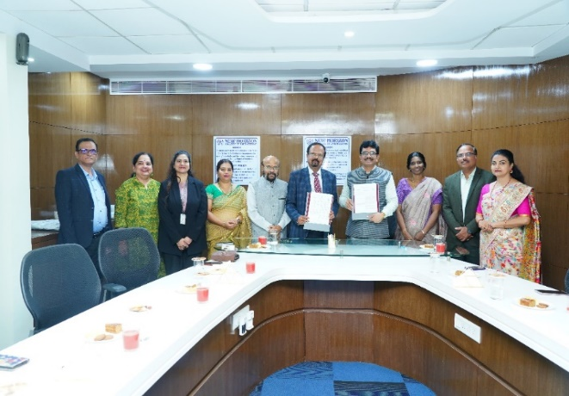
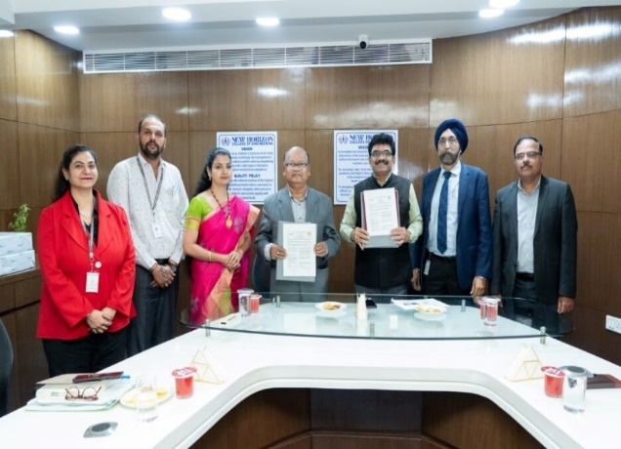
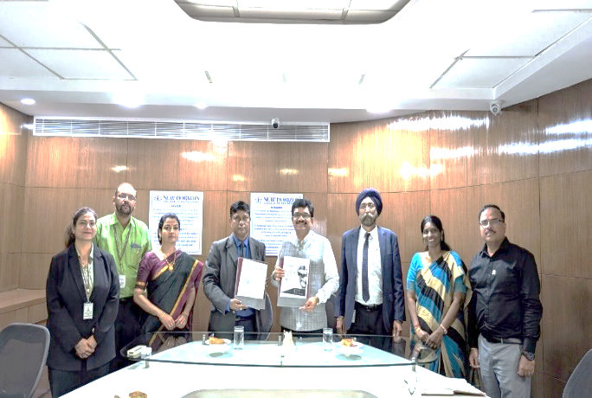
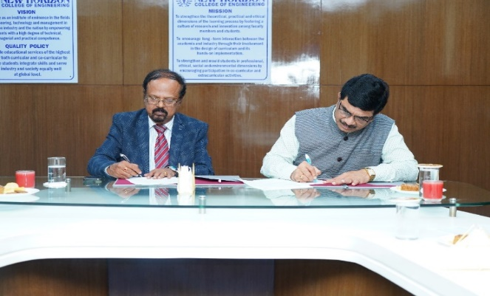
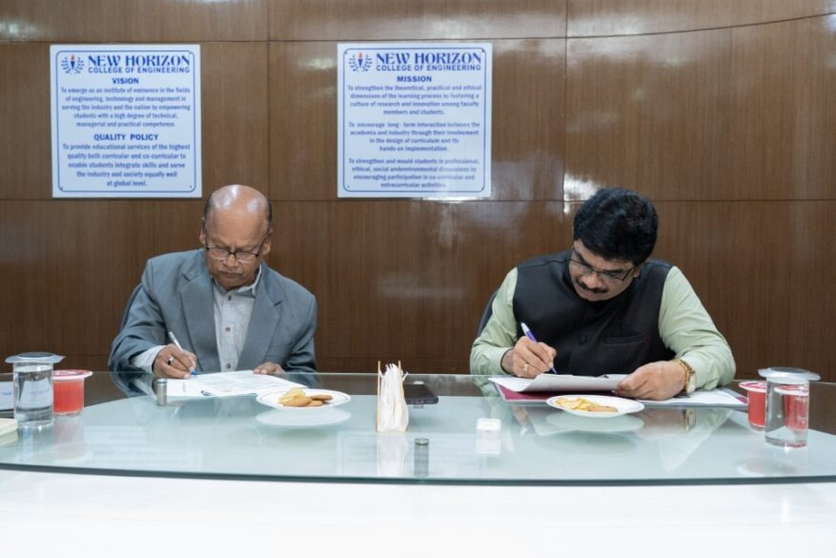
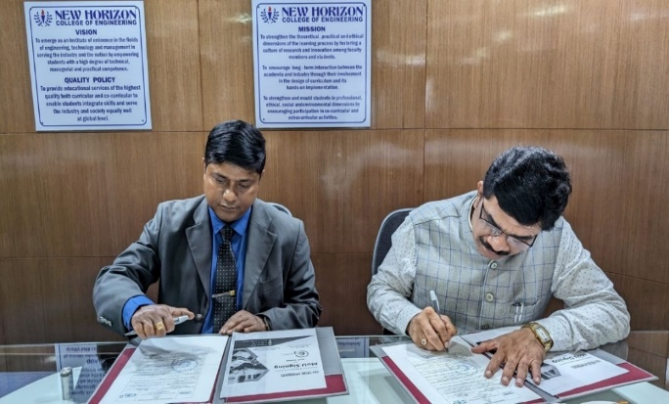





Memorandum Of Understanding (MoU)
KNOWLEDGE PARTNERS
Bangalore Management Association (BMA)
Karnataka Management Association (KMA)
MTC Global

Slide 17




















List of Companies Hiring MBA

